Slide 1
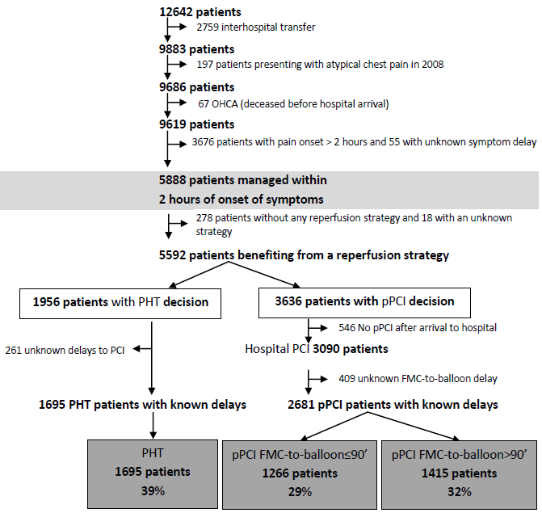
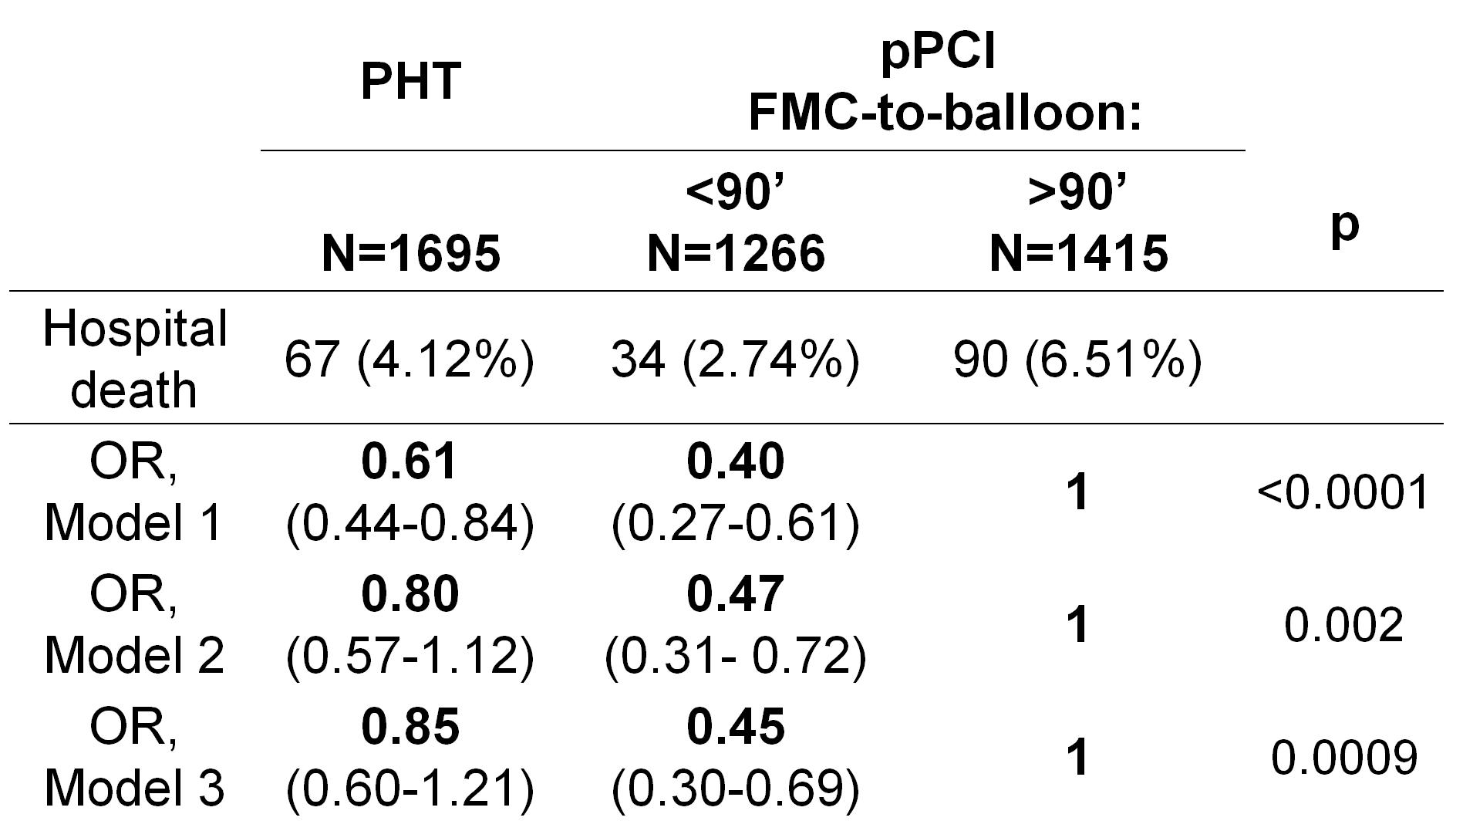
Reperfusion Strategies in Greater Paris Area and Associated Mortality
in a 6-Year Registry
N. Karam¹, M. Tafflet¹, S. Bataille², JM. Juliard³, JY. Letarnec⁴, GA. Capitani⁵, F. Templier⁶, P. Garot⁷, Y. Lambert⁸, X. Jouven¹
(1) Inserm U970 - Paris Cardiovascular Research Center (PARCC), Cardiovascular Epidemiology-Sudden Death, Paris, France
(2) Service des registres ARS Ile-de-France (3) Bichat-Claude Bernard Hospital (4) Melun Hospital
(5) Sud-Francilien Hospital (6) Raymond Poincaré Hospital (7) Cardiovascular Institute Paris-Sud (8) Versailles Hospital
Purpose
Results
When available within 90 min of first medical contact for STEMI patients presenting within two hours of pain onset, primary percutaneous intervention (pPCI) is the preferred revascularization strategy. However, timely PCI is not always possible in real life and a great proportion of pPCI are performed after 90 min. We compared the mortality of pPCI > 90 min to that of pPCI < 90 min, and of pre-hospital thrombolysis (PHT).
In-hospital mortality was significantly highest in the group of pPCI > 90 min (6.5%). It was of 4.12% with PHT, and 2.7%, with pPCI < 90 min (Model 1). The difference remained statistically significant after adjustment for sex, age, gender, infarct location, and delay in FMC (Model 2). However, after adjustment for Parisian regions, the statistical significance was only maintained with pPCI < 90 min (Model 3).
Methods
Conclusion
Our data were taken between 2003 and 2008 from e-MUST, a prospective multicenter registry from the Regional Health Agency in Greater Paris Area that includes all acute STEMI patients managed by mobile intensive care units. Reperfusion strategies were divided into pPCI < 90 min, pPCI > 90 min, and PHT.
We performed an uni and multivariate logistic regression of in-hospital mortality for the 3 strategies with adjustment for baseline characteristics, delays to first medical contact (FMC), and Parisian regions, which have different characteristics regarding their sizes, the number of available cath labs and emergency units, and the density of their populations.
Primary PCI beyond 90 minutes is still performed in 32% of acute STEMI and is associated with an increased in-hospital mortality compared to both pPCI < 90 min and PHT.
Notes:
1

